Slide 1




OPERATIONS RESEARCH CASE STUDY
Opti-Money at Bank Hapoalim, Israel
A model-based investment decision-support system for individual customers built to give every client a personalized, data-driven portfolio recommendation.
  Scope
  Decision problems
  Methodology
  Data
  Objective & constraints
  Users
  Benefits
  Limitations
THE SYNDICATE
Aditya Tarle
Akshat Jindal
Guneesh Gupta
Harshit Gupta
Sarthak Agarwal
Aditya Tarle
Akshat Jindal
Guneesh Gupta
Harshit Gupta
Sarthak Agarwal
Avriel • Pri-Zan • Meiri • Peretz Interfaces, 2004
Source: Avriel, Pri-Zan, Meiri & Peretz (2004), Interfaces 34(1), pp. 39–50 · Bank Hapoalim, Israel
Notes:
1

Slide 2
SECTION 1 — PROJECT SCOPE
What Opti-Money Was Built to Do
Bank Hapoalim needed a systematic way to allocate wealth across asset classes that needs to be personalized per customer and scalable to thousands of profiles.
~60
4
4
Asset Classes
Benchmarks
Risks
Represented in the model
The customer chooses an index to exceed
Selected by the user
What It Does
Why the Bank Built It
  Allocates wealth across ~60 asset classes
  Uses customer-specific goals, horizon, benchmark, liquidity/currency preferences and risk attitude
  Precomputes solutions for instant CRM access
  CRM remains responsible for selecting individual securities
  CRMs followed diversification principles but lacked a quantitative tool for systematic advice
  Bank restructuring emphasized personalized investment guidance and stronger risk management
  Live nonlinear optimization for every consultation would be impractical
  The solution had to scale without slowing face-to-face sessions
Notes:
2

Slide 3
SECTION 2 — DECISION PROBLEMS
Four Core Questions the Model Answers
Opti-Money is an asset-allocation engine, not a stock-picker. It answers four questions for each customer profile.
Personalization
Risk–Return Trade-off
Which mix of asset classes fits this customer’s objectives and horizon?
How much expected return is acceptable for the chosen risk level?
Benchmark Tracking
Rebalancing
How should the portfolio behave relative to CPI, USD, interest-rate or Euro benchmarks?
How much should an existing portfolio change, subject to turnover limits?
Planning Horizon
Operating Cycle
The recommended portfolio is restructured annually. The bank encourages check-up consultations every six months, during which customers can adjust portfolios with CRMs and Opti-Money.
1 year
2 years
5 years
10 years
Liquidity & Currency
Customers can set limits on liquid versus illiquid investments (e.g., bonds and stocks vs. certificates of deposit (CDs)). They also specify whether the investment should be in Israeli or foreign currency.

Slide 4
SECTION 3 — DECISION PROCESS
How the Decision Process Works
The CRM collects a customer profile through four screens; Opti-Money then returns the optimal asset-class allocation.
Investment Preferences
Optimization Server
CUSTOMER PROFILE
Objectives: house, children, personal event or general investing.
Horizon: 1, 2, 5 or 10 years.
Benchmark: CPI, Bank of Israel rate, USD or Euro; multiple goals can be weighted.
OPTIMIZATION SERVER
Profile is sent to a central server holding precomputed optimal portfolios for every possible profile.
Output returns instantly in tables/graphs and breaks major classes into finer classes.
MACRO VIEW
Bank supplies forecasts for CPI and USD exchange-rate change.
Customer/CRM may override forecasts.
Selected benchmark also affects asset selection and risk measurement.
LIQUIDITY & CURRENCY
Customer sets limits on liquid versus illiquid investments (e.g., bonds/stocks vs CDs).
Currency preference: Israeli or foreign.
RISK CLASSIFICATION
Questionnaire assigns one of five levels: low, low-medium, medium, risk-oriented or high-risk.
Risk appetite is inferred indirectly.
After the model responds: the CRM can revise inputs and obtain a new portfolio. The model sets asset-class weights only; the CRM selects individual securities and makes the final buy/sell recommendations.

Slide 5
SECTION 4 — METHODOLOGY
Methodology: From Customer Input to Portfolio Output
The model converts customer preferences, market data and constraints into a balanced, implementable portfolio.
MODEL WORKFLOW
1
Collect customer inputs
Objectives, investment horizon, benchmark, liquidity, currency preference and risk category.
5
Balance risk and diversification
Minimize the selected risk measure plus a small penalty for moving too far from the market portfolio. This reduces extreme “corner” portfolios.
2
Prepare model data
Load asset-class returns, expected future returns, benchmark returns and market-portfolio weights.
6
Build the efficient frontier
  Find the minimum-risk portfolio.
  Find the maximum-return portfolio.
  Solve additional problems at intermediate target returns.
3
Select the risk measure
Measure risk using benchmark-relative variability, downside risk, multiple benchmarks or classical Markowitz variance.
7
Make the portfolio executable
Round the continuous asset weights to practical investment %s.
4
Define the optimization model
Choose portfolio weights such that:
  all weights add to 100%;
  short selling is not allowed;
  customer, liquidity, currency and turnover limits are satisfied.
8
Return the recommendation
Show the asset-class allocation to the CRM. The CRM then selects individual securities and discusses the final recommendation with the customer.
SOFTWARE
GAMS
optimization modeling
MINOS
nonlinear solver
Delphi
Windows interface / data bridge
Implementation choice: thousands of nonlinear optimizations are run automatically in batch mode; stored solutions are retrieved instantly during CRM consultations.
5

Slide 6
SECTION 5 — DATA
Where Do the Inputs Come From?
Different inputs come from the customer/CRM, the bank’s expert forum, historical market data, and the existing portfolio.
Provider | Input data / source details | Timing / role in model
Customer / CRM | • Objective and horizon: 1, 2, 5 or 10 years • Benchmark: CPI, Bank of Israel rate, USD or Euro • Liquidity, currency and risk preferences • Customer or CRM may override macro forecasts | • Entered during consultation • Profile can be revised and the portfolio regenerated
Senior Advisors’ Forum | • Monthly CPI and USD exchange-rate forecasts • Benchmark and market outlook • Special sessions for major economic or political events | • Supplies external forecasts • Updated monthly and after major events
Analytics Development / Bank | • Historical returns used to measure risk • Expected future returns supplied separately • Asset definitions and model parameters • Approximately 60 asset classes | • Feeds the monthly batch runs • Produces solutions for each customer profile
Existing Portfolio | • Current asset mix • Used when turnover is constrained • Illiquid-asset limits may also apply | • Supports portfolio rebalancing • Portfolios are normally restructured annually
Key distinction: Historical returns measure risk. Expected future returns and macroeconomic forecasts are external inputs. The selected benchmark also provides the historical series used for benchmark-relative risk.

Slide 7
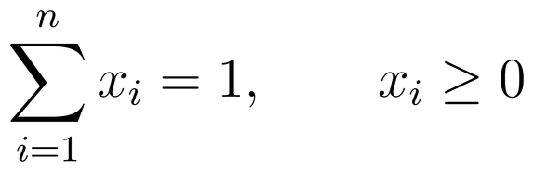
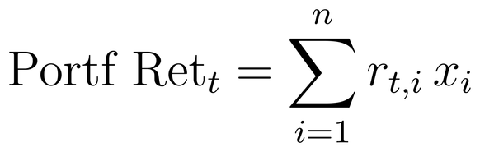
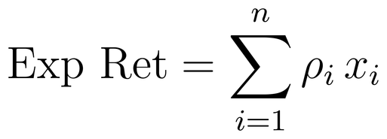
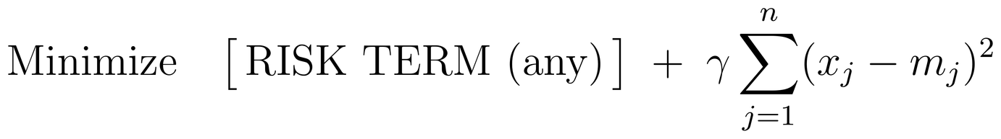
SECTION 6 — VARIABLES & OBJECTIVE
Decision Variables & Objective Function
The decision variables are portfolio weights across asset classes; the model balances return, risk and diversification.
Portfolio variables
Return data
x₁, x₂, …, xₙ are the fractions of the portfolio invested in assets i = 1, …, n.
• Historical returns rₜ,ᵢ for t = 1, 2, …, T; typically monthly returns with T = 36.
• Expected future returns ρᵢ on all assets, e.g. for the next year.
• Expected future return is not necessarily the expected historical average.
Basic portfolio construction
Classical Markowitz principle
All asset fractions sum to the full portfolio; the appendix states xᵢ ≥ 0.
• Historical returns are used internally to compute risk.
• Portfolio variance is the classical measure of risk.
• Maximize expected return at a given risk level, or minimize risk at a given expected return level.
Historical portfolio return
Expected future return
Additional practical constraints
• Turnover can limit the percentage of new assets relative to the existing portfolio.
• Customer-specific rules can restrict asset inclusion and the fraction of illiquid assets.
OBJECTIVE FUNCTION
7

Slide 8
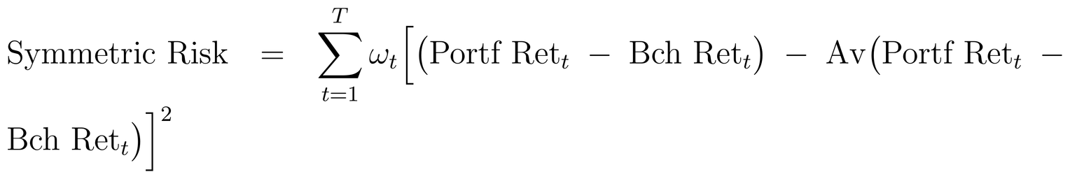
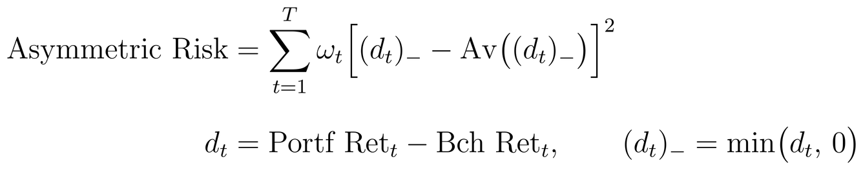
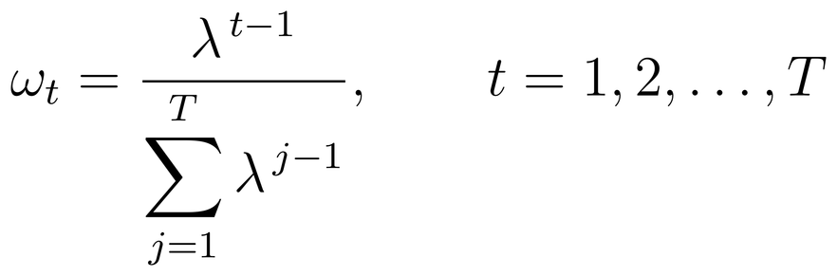
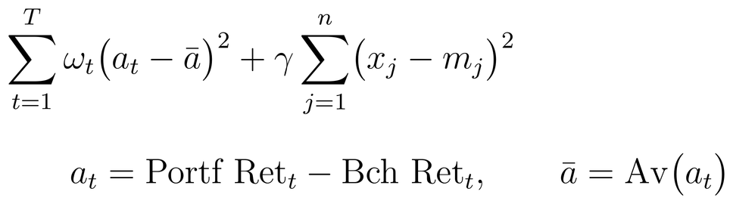
SECTION 7 — RISK MEASURES
Risk Measures & Mathematical Modifications
Opti-Money extends basic Markowitz by measuring risk relative to benchmarks, emphasizing downside performance and lightly tracking the market portfolio.
Symmetric return variability around a benchmark
Asymmetric downside risk
Measures up- and down-variability of portfolio performance around a known benchmark.
Keeps only underperformance relative to the benchmark.
Exponentially decaying historical weights
Modified risk measure with market tracking
The model usually observes T = 36 months. λ = 1 gives equal weights; the paper gives λ = 0.95 as an example, so recent observations receive greater weight.
γ is a small positive constant; the second term is the Euclidean distance from the value-weighted market portfolio.

Slide 9
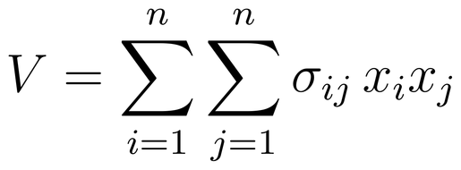
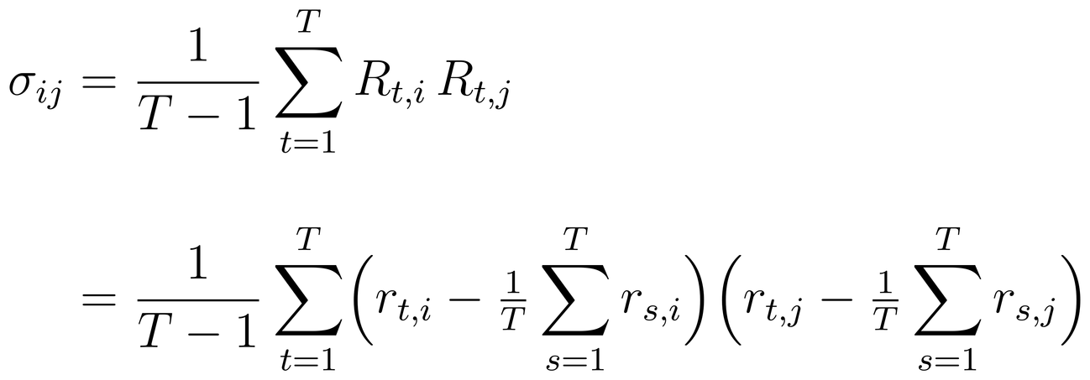
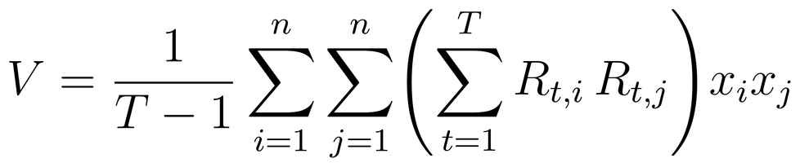
SECTION 8 — CONSTRAINTS
Classical Markowitz Risk & Practical Constraints
The classical Markowitz risk measure provides the mathematical risk foundation; practical portfolio rules are then layered onto the optimization.
Classical Markowitz portfolio risk
COMPOSITION OF OPTIMAL PORTFOLIOS
Why the basic optimum can be impractical
Benchmark-relative optimization can produce “corner” solutions: zero weights in many assets and very large weights in others. Opti-Money adds a small market-portfolio tracking term to obtain balanced portfolios without significant compromise in frontier optimality.
V is the portfolio variance; σᵢⱼ are the covariance terms between historical returns of assets i and j.
Constructing a balanced efficient frontier
Covariance between asset returns
• 1. Find the portfolio with minimum risk + tracking error, irrespective of expected return.
• 2. Find the portfolio with maximum expected return, irrespective of portfolio risk.
• 3. Compute K intermediate expected-return points between the two extremes (e.g., equally spaced).
• 4. Solve K optimization problems minimizing risk + tracking error subject to those expected-return targets; together with the endpoints, these form a discrete approximation of the frontier.
Equivalent expression used in the appendix
Postoptimal adjustment
• Round asset fractions to predetermined discrete values before execution.
• The authors use continuous programming plus a rounding procedure instead of a mixed-integer nonlinear formulation.

Slide 10
SECTION 9 — IMPLEMENTATION
Software Architecture & Implementation at Scale
A monthly overnight batch solves the nonlinear optimization for every customer profile in advance, so a live consultation only ever retrieves a precomputed answer.
OFFLINE · MONTHLY OVERNIGHT BATCH
ONLINE · INSTANT RETRIEVAL, NO SOLVER CALL
Historical & Forecast
Data
GAMS / MINOS
Optimization Engine
Central
Solution Store
CRM Desktop UI
Customer / CRM
Consultation
Why batch processing?
Implementation scale
47
485
228
  Nonlinear (Markowitz-type) optimization is computationally demanding to solve on demand.
  Each monthly run solves tens of thousands of customer-profile combinations — about 36,000 portfolios — in one unattended overnight batch.
  CRMs then retrieve the matching solution instantly during a live consultation — no waiting on an optimizer, no risk of a stalled session in front of a customer.
Units (1998)
CRMs (2003)
Branches
Private-banking units
at launch
Active CRMs across all
branches, using the system
Bank branches with
Opti-Money deployed
Consultation volume grew from 224 sessions in the first month (1998) to 17,743 sessions in a single month by December 2002.
Built in a 22-month development effort for roughly $240,000 (about $220K in personnel time, $20K in software and hardware) and still run today by a 3-person team — modest cost for a system now central to 133,000+ consultations a year.

Slide 11
SECTION 10 — USERS
Who Uses the Model?
The system supports people, it does not replace the advisory role of the Customer Relations Manager.
1
Primary users
2
Beneficiaries
Customer Relations Managers (CRMs)
Private-banking customers
Use Opti-Money during consultation sessions to generate asset class allocation and translate it into specific buy/sell asset recommendations.
Receive customized allocations across 60 asset classes based on risk, horizon, liquidity, and chosen benchmark (CPI, Shekel, USD, EUR).
3
Secondary users
4
Special users
Branch / bank managers
Institutional investors
  Promote adoption, understand system usage and encourage decision-support activity across branches by analyzing usage analytics.
  Ensure advisory compliance and operational alignment across regional centers.
  Can run special sessions using forecasts based on their own assessments of the capital market.
  The system makes recommendations accurately suited to their assessments of the capital market
Design principle: formal optimization + human advisory judgment. The model determines asset-class weights; CRMs retain responsibility for the detailed security recommendations and the customer conversation.
Notes:
11

Slide 12
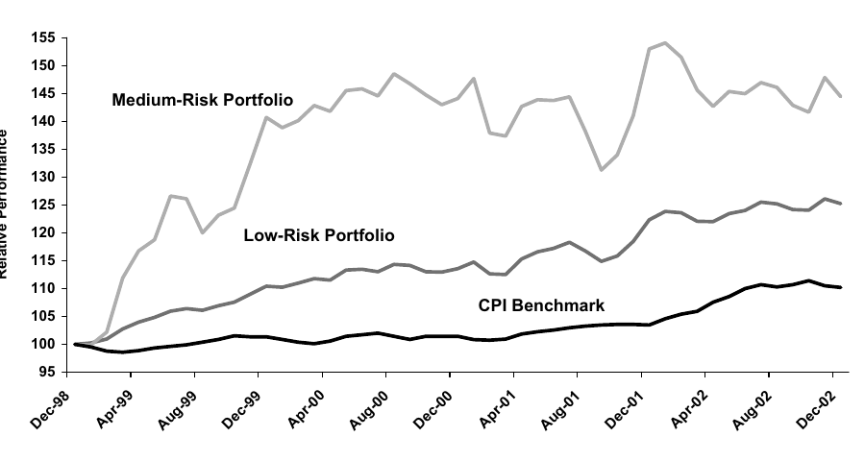
SECTION 11 — RESULTS
Decision Quality: CPI Benchmark Track Record
The paper compares representative low- and medium-risk portfolios with their benchmarks over January 1999–December 2002.
Risk levels tested
Low-risk portfolio = risk scale 1
Medium-risk portfolio = risk scale 3
A risk scale of 5 exists in the customer classification, but the published track-record analysis uses low + medium risk portfolios.
CPI benchmark result
Low risk: +15.03% cumulative excess return
Medium risk: +34.22% cumulative excess return
The figure shows relative performance indexed at 100 in Dec-1998.
Assessment approach
Compare realized portfolio performance with the selected benchmark. The paper also evaluates bank-side profit and adoption/usage.
Notes:
12

Slide 13
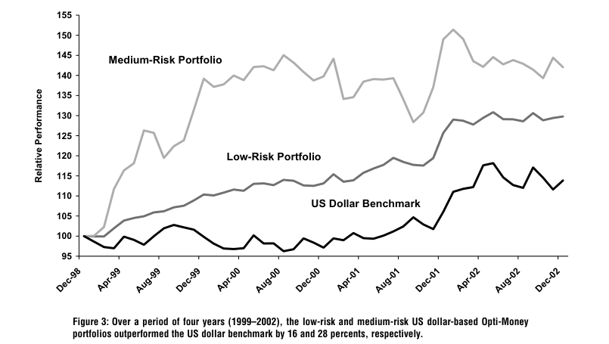
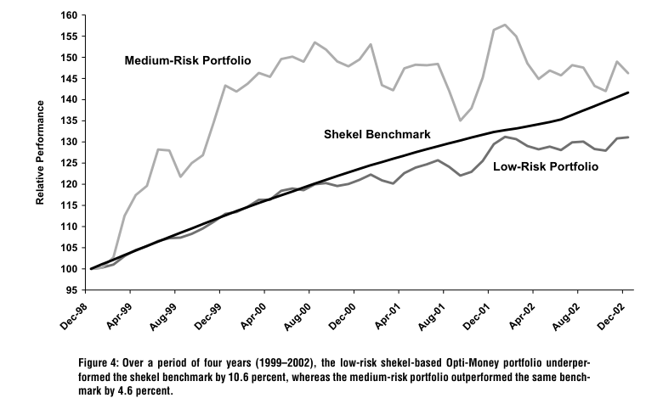
SECTION 11 — RESULTS
Cross-Benchmark Graphs: Low vs Medium Risk
The paper reports low-risk and medium-risk portfolios against USD and shekel benchmarks over the same 1999–2002 period.
US Dollar Benchmark
Shekel Benchmark
Reported cumulative excess returns
What the six-case check shows
Five of six representative low/medium-risk portfolios beat their selected benchmark. The paper notes that the low-risk shekel case was the one exception.
USD benchmark: low +15.92%; medium +28.20%
Shekel benchmark: low −10.57%; medium +4.56%
Notes:
13

Slide 14
SECTION 12 — BENEFITS
Earlier Planning Process vs. After Opti-Money
The documented change is from judgment-led advice without a quantitative engine to systematic, scalable, model-based asset allocation.
Earlier planning process
After Opti-Money
• CRMs used diversification principles and professional judgment.
• No quantitative models/tools were available for systematic portfolio advice.
• Portfolio construction depended more heavily on manual CRM judgment.
• Complex nonlinear optimization could not realistically be performed live for every customer.
The paper does not say the earlier process was “wrong”; the gap was the lack of quantitative and scalable decision support.
• Tailor-made asset allocation based on explicit customer inputs.
• Instant portfolio retrieval through centralized precomputation.
• Consistent treatment of risk and benchmarks across thousands of profiles.
• Quantified performance and profitability measures.
• Human CRM judgment remained in the loop.
Measured impact in the 2002 case analysis
$31.7M
$244.2M
Scale: 63,225 customers used Opti-Money in 2002 across 133,393 consultation occasions. The average monthly profit/account for private-banking customers using Opti-Money was 422.0 shekels versus 224.2 without it.
Bank profit contribution
Customer earnings
Estimated annual contribution in 2002
Estimated annual earnings above benchmarks
Notes:
14

Slide 15
SECTION 13 — LIMITATIONS & TAKEAWAYS
What Should We Be Cautious About?
All optimization models are imperfect; the case itself highlights assumptions, data dependence and implementation trade-offs.
Final takeaways
Limitations / Assumptions
• Expected returns and macro forecasts are exogenous and can be wrong.
• Customer profiles are discretized into a limited set of parameter values, motivating thousands of precomputed frontiers.
• Continuous nonlinear optimization + post-optimal rounding is an approximation to a full mixed-integer formulation.
• The paper notes limited information on how CRMs select customers into the Opti-Money group.
• Evaluation is historical (1999–2002); future performance stability is not established.
1
Scope
Personalized asset allocation for private-banking advisory.
2
Method
Modified Markowitz + nonlinear programming + efficient frontier.
3
Data
Customer inputs + bank forecasts + historical market returns.
4
Decision quality
Benchmark performance + risk/return + bank profitability.
Evaluation caveat: the bank itself acknowledges uncertainty about customer selection into the Opti-Money user group, so comparisons of profitability should be interpreted as observational case-study evidence.
5
OR lesson
Optimize the decision, but keep the human in the loop.
Notes:
15

